Slide 1
Real-Time Volumetric Rendering
Revision 2013 Demo Party
Notes:
Hi folks, I’m Patapom from Bomb! and I’m going to talk about …

Slide 2
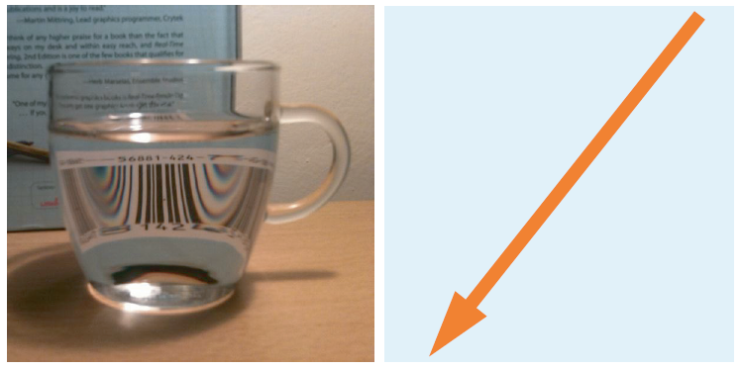
Participating Medium
A participating medium is a volume in which we consider the change in ambient properties (e.g. index of refraction, density, albedo) to be significant enough to deserve a more accurate computation.
Example :
Air is usually ignored in rendering because distances are short
Can’t ignore anymore when rendering the entire atmosphere (i.e. blue sky, red sunset, etc.)
Notes:
To account for rapid changes in the properties of the medium, we need to frequently sample the medium at different positions along a ray: we need to use ray-marching.
Many of you must be familiar with distance field ray-marching, well this is exactly the same here except we sample for incoming light and medium density rather than a distance.

Slide 3

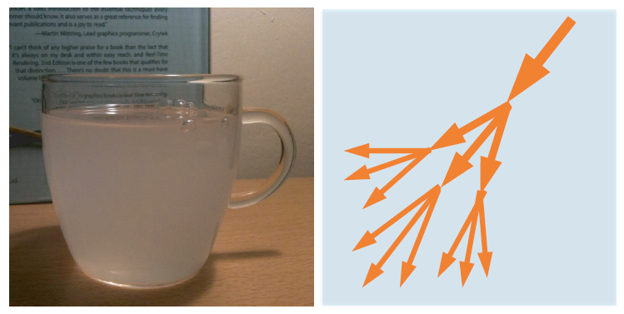
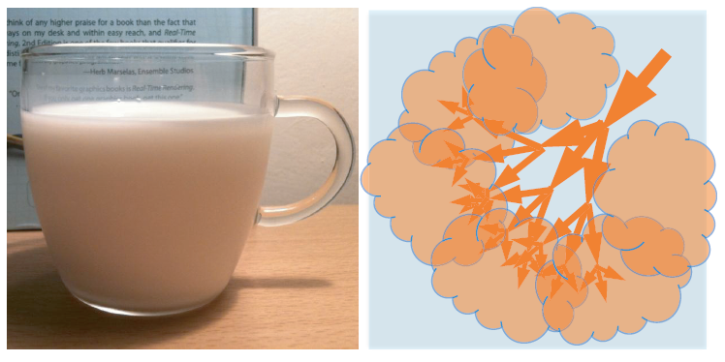
Absorption & Scattering
Absorption : photons interact with particles and transform into something else (e.g. heat). The net effect is a loss of luminous intensity.
Scattering : photons are bouncing off of particles in various directions. Depending on the density and type of particles, scattering is more or less random, more or less frequent.
Both events can be wavelength-dependent.
The total loss of photons due to absorption and out-scattering is called the extinction
But we can also gain some energy due to photons bouncing back in view direction, this is called in-scattering
Notes:
These represent the main events present in a participating medium.
Absorption is responsible for a loss of energy while scattering is responsible for both loss and gain of energy: indeed, some photons bounce off the view direction and are lost to the viewer, but other photons coming from other directions can bounce back into view direction actually adding some light.
Scattering and absorption are more or less wavelength-dependent. For example, Rayleigh scattering is dependent on the fourth power of the wavelength: scattering is more important for shorter wavelength, this is why the sky will « reflect » more blue light than red light.

Slide 4
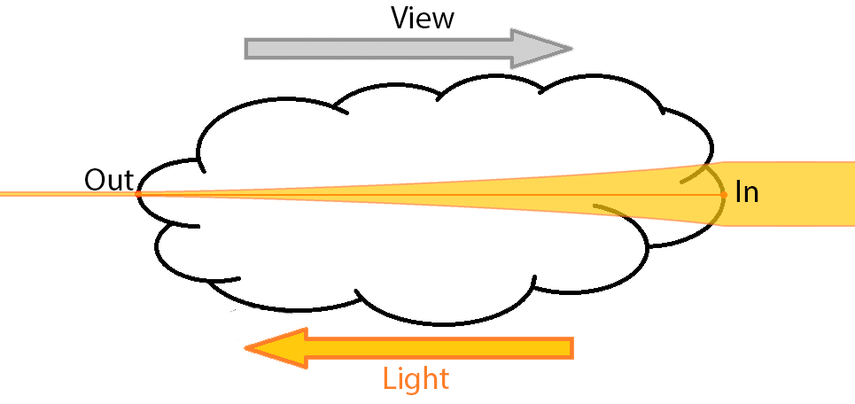
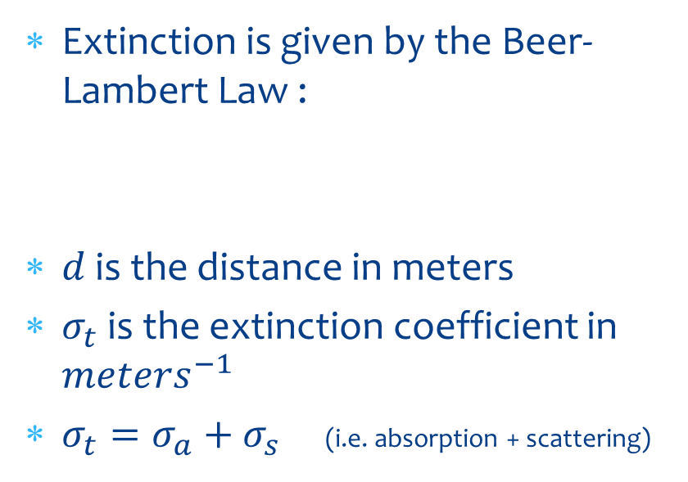
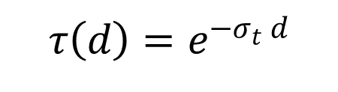
Beer-Lambert Law
Extinction is given by the Beer-Lambert Law :
$d$ is the distance in meters
$σ_{t}$ is the extinction coefficient in ${meters}^{−1}$
$σ_{t}=σ_{a}+σ_{s}$ (i.e. absorption + scattering)
$$τ\left(d\right)=e^{−σ_{t} d}$$
Notes:
We use this to model our loss of intensity.
The loss of intensity is due to both absorption and scattering so sigma_t is the sum of sigma_absorption and sigma_scattering.
We notice that the extinction works in an exponential way: this is the continuous way of saying that a photon has a probability of hitting a particle that grows exponentially with distance in a medium of a specific density containing particles of a specific size.

Slide 5
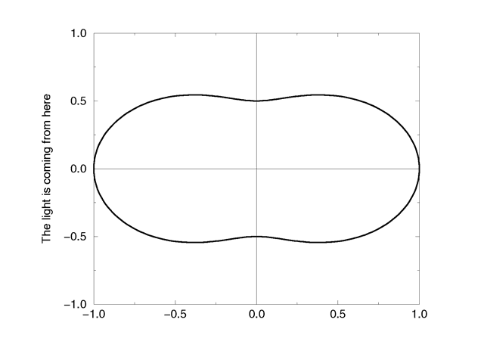
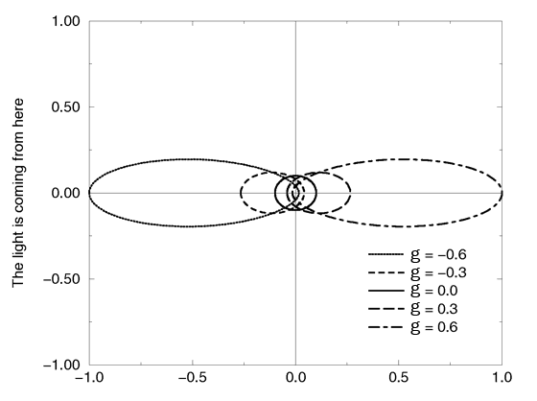
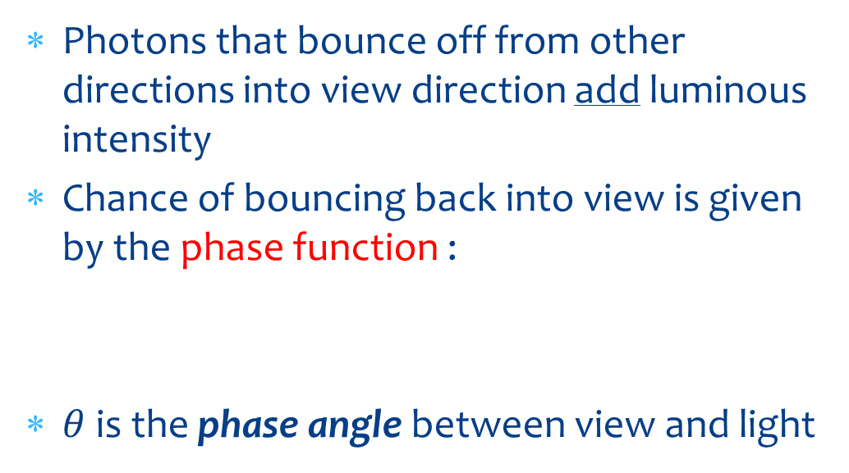
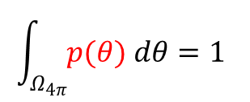
Phase Functions
Photons that bounce off from other directions into view direction add luminous intensity
Chance of bouncing back into view is given by the phase function :
$θ$ is the phase angle between view and light
Rayleigh
$$\int_{Ω_{4π}}{p(θ) dθ}=1$$
Henyey-Greenstein
Notes:
Phase functions are a way of modeling how much chance photons will bounce back into view direction when coming from a particular angle.
The phase function of an actual cloud is obviously much more complex and difficult to use but we can model it using a combination of simpler phase functions like the Rayleigh or Henyey-Greenstein functions.
Phase functions are the equivalent of the BRDF for standard materials: it’s a black box that models the interaction of light with the medium. It’s the best thing we can do to macroscopically describe these interactions, short of performing computations involving quantum mechanics. ☺

Slide 6
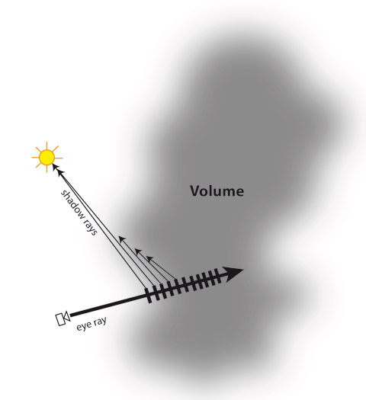
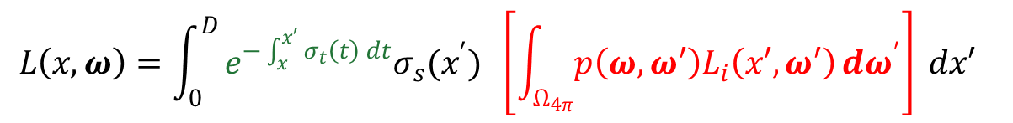
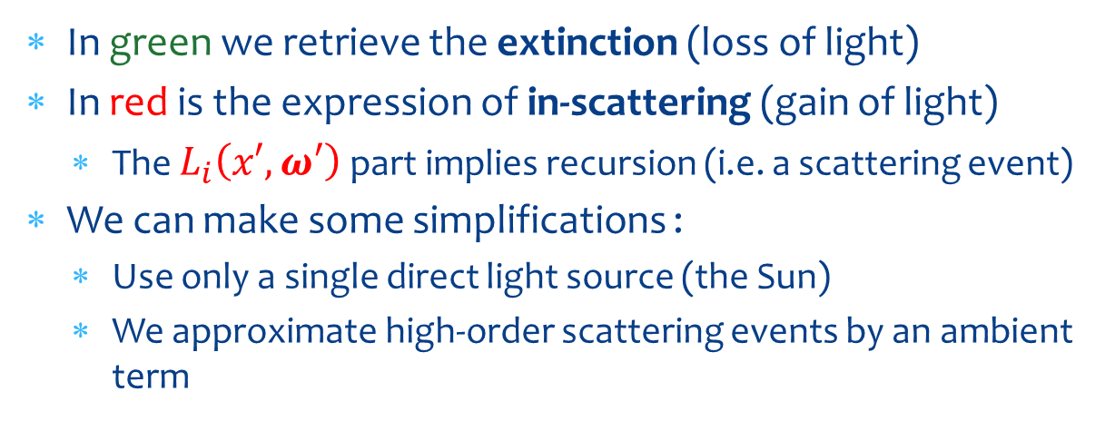
Complete Equation
$$L\left(x,ω\right)=\int_{0}^{D}{e^{−\int_{x}^{x′}{σ_{t}\left(t\right) dt}}σ_{s}(x^{′}) } \left[\int_{Ω_{4π}}{p\left(ω,ω′\right)L_{i}\left(x′,ω′\right)}dω^{′}\right] dx′$$
In green we retrieve the extinction (loss of light)
In red is the expression of in-scattering (gain of light)
The $L_{i}\left(x′,ω′\right)$ part implies recursion (i.e. a scattering event)
We can make some simplifications :
Use only a single direct light source (the Sun)
We approximate high-order scattering events by an ambient term
$$L\left(x,ω\right)=\int_{0}^{D}{e^{−\int_{x}^{x′}{σ_{t}\left(t\right) dt}}σ_{s}(x^{′})} \left[p_{sun}\left(ω,ω_{sun}\right)L_{sun}\left(x′,ω_{sun}\right)+ p_{amb}L_{amb}\right] dx′$$
Notes:
Parameters in bold are vectors. Omega and Omega’ are 3D direction vectors.
We must integrate on a path of length D. This is where the need for ray-marching is becoming apparent. Values with (x’) change with position and need to be sampled often (the sampling frequency depending on the rate of change of the parameters).
(explain parts of the integral)
Integrate radiance coming from all directions. But radiance in another direction involves recomputing that very same integral on that other path! Recursion! Death!
But multiple scattering is essential for a good looking cloud or smoke puff. Single scattering is not enough!
Ambient term : same idea as behind the ambient term of global illumination.
We can incorporate ambient lighting from the Sun, the Sky or even the ground (i.e. reflection of the Sun off the ground)

Slide 7
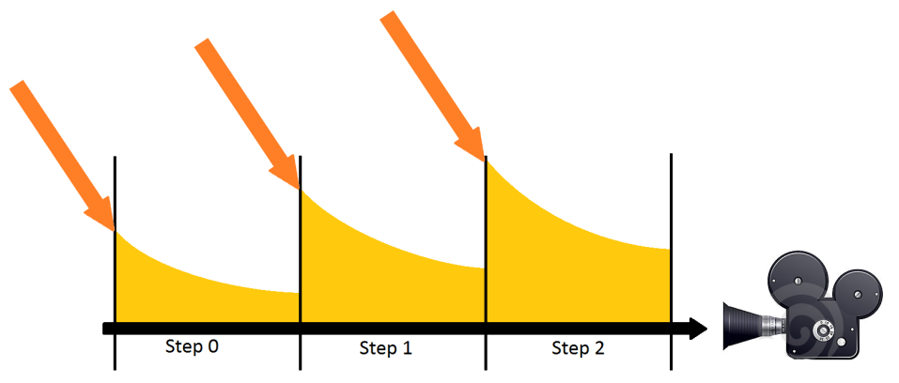
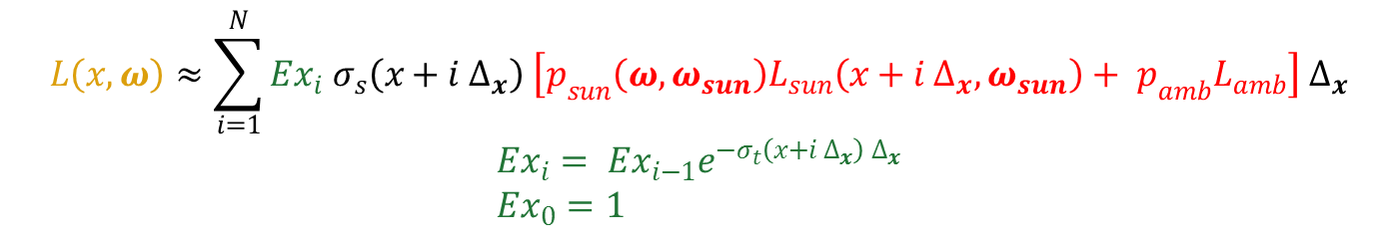
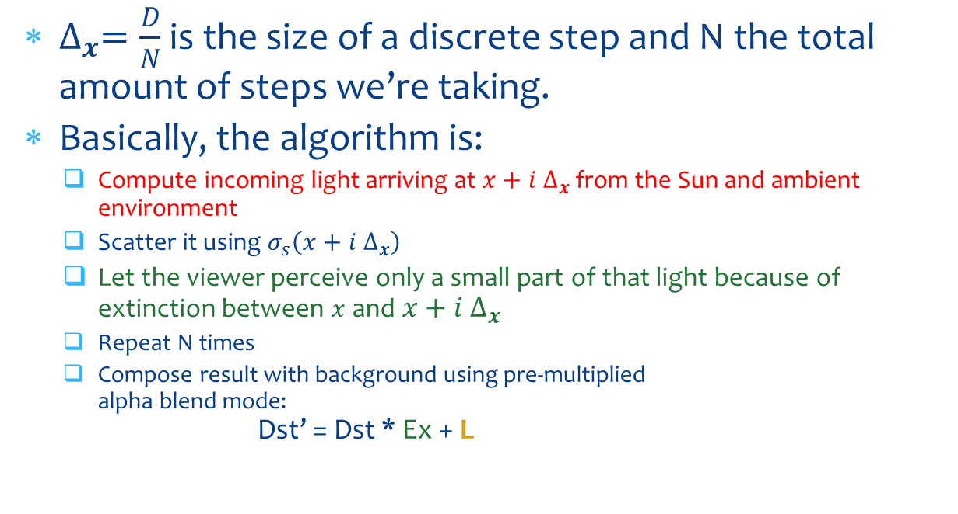
Discrete Simplified Equation
$$L\left(x,ω\right)≈\sum_{i=1}^{N}{{Ex}_{i} σ_{s}\left(x+i{ ∆}_{x}\right) \left[p_{sun}\left(ω,ω_{sun}\right)L_{sun}\left(x+i{ ∆}_{x},ω_{sun}\right)+ p_{amb}L_{amb}\right] ∆_{x}}$$
$${Ex}_{i}= {Ex}_{i−1}e^{−σ_{t}\left(x+i{ ∆}_{x}\right) ∆_{x}} \\ {Ex}_{0}=1$$
$∆_{x}=\frac{D}{N}$ is the size of a discrete step and N the total amount of steps we’re taking.
Basically, the algorithm is:
Compute incoming light arriving at $x+i{ ∆}_{x}$ from the Sun and ambient environment
Scatter it using $σ_{s}\left(x+i{ ∆}_{x}\right)$
Let the viewer perceive only a small part of that light because of extinction between $x$ and $x+i{ ∆}_{x}$
Repeat N times
Compose result with background using pre-multiplied alpha blend mode: Dst’ = Dst * Ex + L
Notes:
We discretize the previous integral by taking some small steps Delta_x (possibly with a varying step size, but constant step is okay).
I separated extinction into a second series that behaves as a product, something that we can store in a register on the side along our ray-marching loop.
This means that extinction « accumulates » exponentially: previous extinction is multiplied with new extinction from current step.
On the other hand, in-scattered radiance L (perceived by the camera) is accumulated with current step in-scattered radiance: it’s an additive process.
For this reason, we exit the loop and obtain 2 values: L and Ex_n that represent the energy we gained along the path, and the opacity of the medium along that path respectively.
We can then compose this using pre-multiplied alpha…

Slide 8
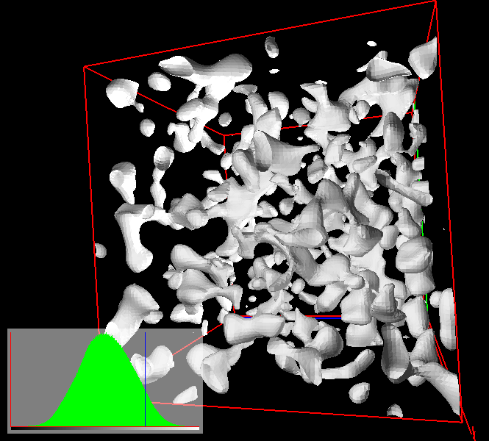

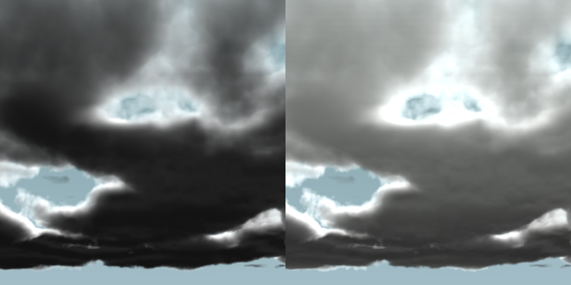
Shader Requirements
To properly compute the previous equation, we need:
The density of the medium at any given 3D position
3D Noise Evaluation with fractional brownian motion
The direct Sun light reaching the 3D position
Volumetric Shadow Mapping (deep shadow maps, transmittance function maps, etc.)
A way to approximate the ambient term
Cheap hack, but efficient!
Notes:
* The noise can come from a 3D texture or any noise function you can find (use iQ’s shader toy examples).
Use fbm to combine several octaves.
Use scale / bias / exponent to modulate the density value.
* For self-shadowing, I would advise to use Transmittance Function Maps that yield good results. Beware of the inverse DCT, not detailed in the paper! (check wikipedia)
* Ambient term detailed in the companion course note.

Slide 9
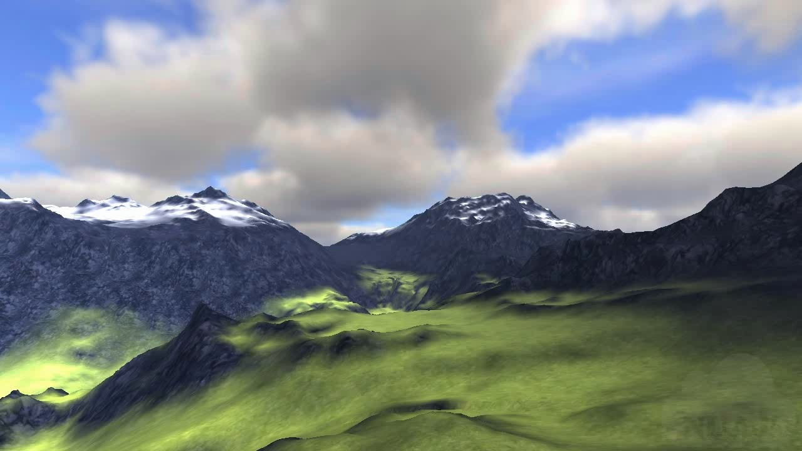
Video

Slide 10
Thanks!
The companion course notes with more details and shader snippets is available at…
www.patapom.com
Notes:
Bisous !

